Slide 1

OID to Open LDAP Modernization Program Design review
Replacing Legacy Identity Stack with Secure, Scalable LDAP
11,June,2026

Slide 2
Executive Summary
Objective:
-Replace OID, OAM, SSO, FCDB, and SSO Admin Tools with a modern OpenLDAP-based platform to
Simplify identity architecture and reduce operational complexity
Improve security posture with modern encryption and hashing
Status:
-90% Analysis completed
-Architecture implemented in the development environment .
-POC for migration completed
-Design 70%

Slide 3
Overview
Multiple identity components:
• OID
• OAM
• SSO + FCDB
• SSO Admin Tools
Key challenges:
• High operational overhead
• Redundant and unused identity data
• Deprecated password hashing (SHA-1)
• Fragmented administration and governance
• Limited flexibility for future integrations

Slide 4
Program Scope
Installation and Configuration of OpenLDAP Deploy and configure OpenLDAP on a Linux platform, with a preference for Red Hat Enterprise Linux (RHEL), in accordance with enterprise security and operational standards.
Middleware (MW) API Integration Enable and support integration with middleware systems through secure and standardized APIs to facilitate authentication and identity-related services.

Slide 5
Out of Scope
CAE to provides VM and operating system installation and Hardening.
Configure load balancing (VIP/DNS cutover) is out of scope.
Performance and load testing is out of scope.
CAE to provide VM replication setup for DR site.
CAE to provide infrastructure, OS, and certificates.
Failover at DR site is triggered and managed by CAE DR procedures however
No direct LDAP replication between main and DR sites.
The Migration strategy for data from the existing OID to the openLDAP to be defined during the design phase.
Any document requiring approval by CAE to be approved within 3 business days.

Slide 6

Target State Overview
OpenLDAP as the single authoritative identity store
CRM or NCT as the central customer administration system
API-based integration for all consuming systems
Secure-by-design configuration
LDAPS enforced
Strong password hashing
Centralized logging and monitoring

Slide 7
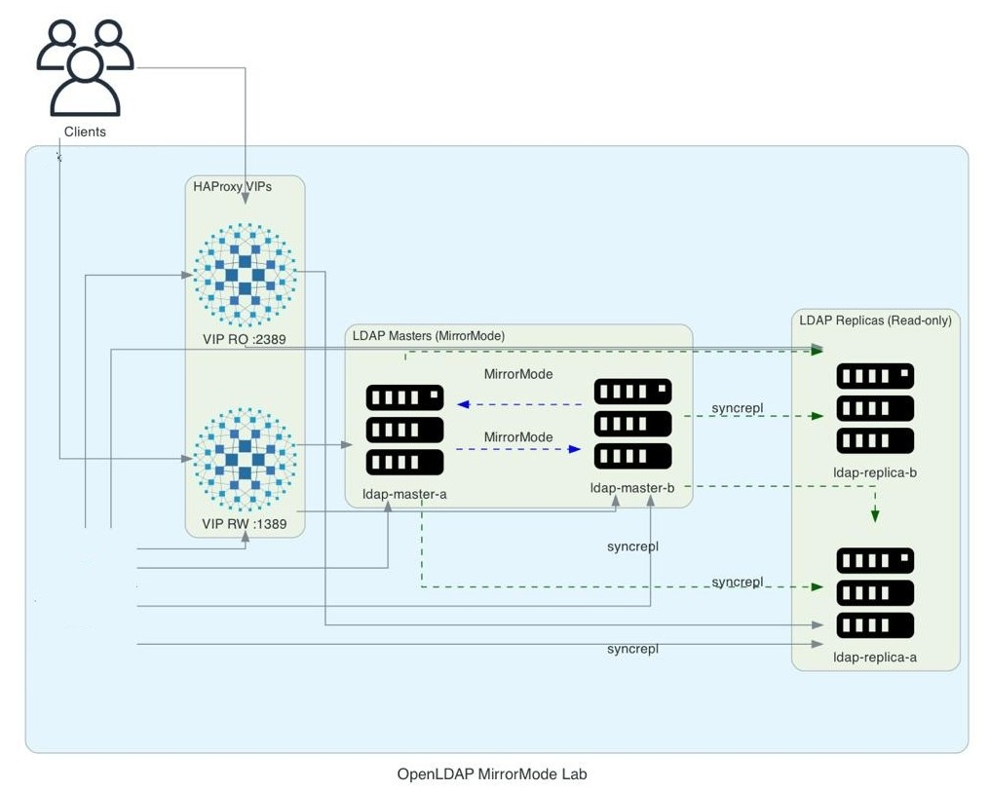
OpenLDAP Architecture

Slide 8
OpenLDAP Architecture
Platform: Red Hat Enterprise Linux
Topology:
2 Masters (Mirror Mode)
2 Read Replicas
Benefits:
Load distribution
No single point of failure
Horizontal scalability
High availability
Data consistency

Slide 9
Directory Structure Design
Logical separation of identities using OUs:
ou=users
ou=admins
ou=systems
Clear separation of concerns:
End users
Administrative users
System/service accounts
Improves security, governance, and auditing

Slide 10
Security Architecture
Secure LDAP Communication
Enforce LDAPS for all LDAP communications to ensure encrypted data transmission.
Operating System Hardening
Implement Red Hat Enterprise Linux hardening in alignment with CAE security baselines and best practices.
Least-Privilege Access Model
Apply a least-privilege access model across all integrations to minimize security exposure.
Role-Based Password Policies
Enforce differentiated password policies for end users, administrators, and service accounts.
Strong Password Hashing
Utilize industry-standard strong hashing algorithms to securely store credentials.
Audit and Logging
Enable comprehensive auditing and logging for all authentication and directory operations.
SIEM Integration Support
Support integration with SIEM platforms through Syslog for centralized monitoring and security analytics.

Slide 11
Password & Policy Management
• Legacy OID passwords migrated successfully
• Current state: SHA1 -based hashing (legacy compatibility)
Post go-live enhancement:
• Upgrade to modern hashing (SHA-256 / bcrypt)
Password policies defined for:
• End users
• Admin users
• System/service users

Slide 12
Enhancements from Legacy OID
• Removal of unused and sensitive legacy attributes
• Mapping to standard LDAP attributes
• Reduced directory footprint
• Improved performance and compliance

Slide 13
CRM/NCT -Centric Customer approach
• All customer related action to be moved to CRM/NCT
– SSO administration
– OAM-related workflows
– Call center identity functions
– Digital channel identity operations
• OpenLDAP related data to be exposed via Middleware APIs
• LDAP acts as backend identity store

Slide 14
Integration Model
• Each connected system has its own LDAP admin/service account
• Dedicated permissions and scope per system
Benefits:
• Strong isolation
• Reduced risk exposure
• Simplified audit and compliance

Slide 15
Monitoring & SIEM Integration
• Syslog enabled on OpenLDAP
• Authentication and access logs forwarded to SIEM
Enables:
• Security monitoring
• Incident detection
• Audit and compliance reporting

Slide 16
Migration Strategy
Approach
User Migration from OID to OpenLDAP Migrate user accounts from Oracle Internet Directory (OID) to OpenLDAP using an LDIF-based ETL process.
Limitation
The new password Hashing will be applied after migration
The password history can’t be migrated
Key Benefits
Single Centralized Directory Establish a single source of truth for all user identities.
Reduced Middleware Load Minimize dependency on middleware for identity resolution and synchronization.
Improved Customer Login Performance Enable faster and more efficient customer authentication processes.
Immediate Legacy Decommissioning Allow prompt decommissioning of legacy identity systems, reducing cost and operational risk.

Slide 17
Go-Live Approach
Phase 1 – Pilot:
• Internal staff pilot
• Banki pilot environment
• Functional, security, and performance validation
Phase 2 – Full Rollout:
• full rollout for customer
• Decommission legacy components after stabilization

Slide 18
Key Business & Technical Benefits
• Simplified identity landscape
• Reduced licensing and operational costs
• Improved security compliance
• Scalable and future-ready architecture
• Clear ownership and governance model

Slide 19
Next Steps
Complete the Analysis and Design Phases Finalize all analysis and solution design activities.
Finalize the Project Plan Confirm scope, timelines, milestones, and responsibilities.
Approve Design Deliverables Review and formally approve the analysis and design documentation.
Prepare the Testing Environment Provision the testing environment and implement the agreed communication matrix.
Initiate Implementation Commence the implementation phase in accordance with the approved plan.

